Slide 1
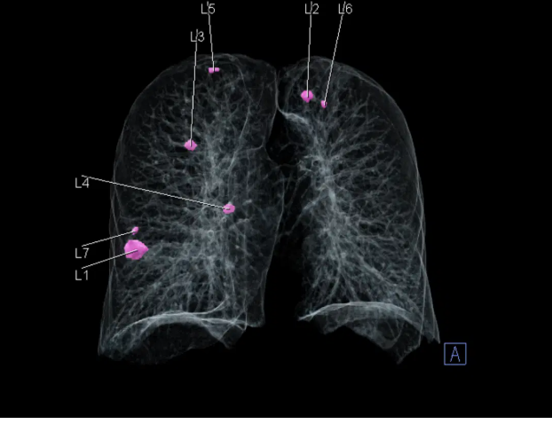

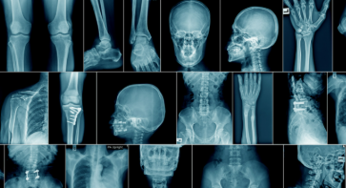
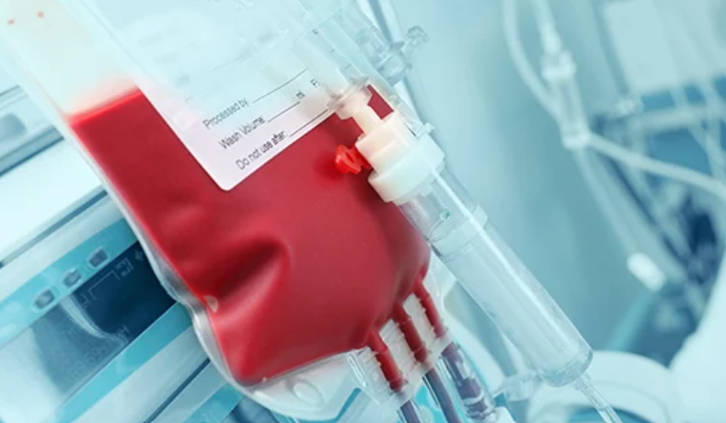
Real world research that translates to care
DART: Integration and Analysis of Data using Artificial Intelligence to Improve Patient Outcomes with Thoracic Diseases
400,000 lung cancer screening records now held (150,000 with one or more CT scans).
DART is the largest dataset of its kind in the world
CSOR: Children’s Surgery Outcome Measures Programme
it is possible to reduce unwarranted variation in the health and wellbeing of children undergoing early surgery at different hospitals in England and Scotland.
Delivering translational impact to NHS frontline and benefits to patients
SAMURAI: Systematic Assessment of the Medical Utility of Radiology AI
evaluating the real-world impact of implementing Radiobotics' AI-powered fracture detection tool, RBfracture™ in clinical workflows
UK’s first multicentre RCT of AI-assisted fracture detection in the ED – addressing NICE evidence gap
PBMPC: Patient Blood management and perioperative care
Bringing together real-world NHS data to help understand who receives transfusions and whether they follow best practice.
Generating evidence to drive national policy
Notes:
Kerrie
We’ve given three examples in our submission, here are four more projects that showcase the breadth and depth of the data linkages the SDE…
38 research projects live/completed;
210 opportunities in the pipeline
Cancer most popular therapeutic area
Over 25% pipeline AI related
Further to the examples we shared in our original submission, here are four more projects that showcase the breadth, depth and impact of the SDE…
DART
DART uses AI to review lung check data & imaging to:
better identify non-cancerous nodules as well as other diagnoses such as heart or other lung problems
speed up diagnosis of early-stage lung cancer
Reduce unnecessary investigations
Improve safety and reach of life-saving Lung Health Checks
evaluate the real-world impact of implementing Radiobotics' AI-powered fracture detection tool, RBfracture™ in clinical workflows across four NHS Trusts in the Thames Valley.
CSOR
Half a million children in England and Wales undergo surgery each year
there is significant variation in the way children are treated for surgical conditions (conditions which usually, but not always, require an operation).
at the moment, we do not know which parts of this variation affect how successfully children are treated.
It will only be possible to find this out if reliable information can be collected about how children are currently treated, and this information can be linked to information about their long-term health and wellbeing.
The CSOR programme aims to do just this.
Additionally, the programme aims to provide a mechanism by which hospitals can compare their own practice to that of others, and elements of good practice can be easily identified and shared.
By trying to identify and promote areas of best practice, the CSOR programme will hopefully provide a mechanism for improving the number of children that are successfully treated, as well as improving the experience of children and their carers.
To begin with, CSOR will look at six conditions for which children undergo early surgery:
oesophageal atresia,
gastroschisis,
Hirschsprung's disease,
posterior urethral valves,
congenital diaphragmatic hernia, and
necrotisising enterocolitis.
Quote from researchers?

Slide 2
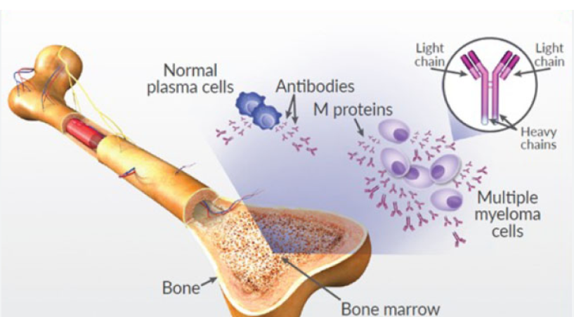
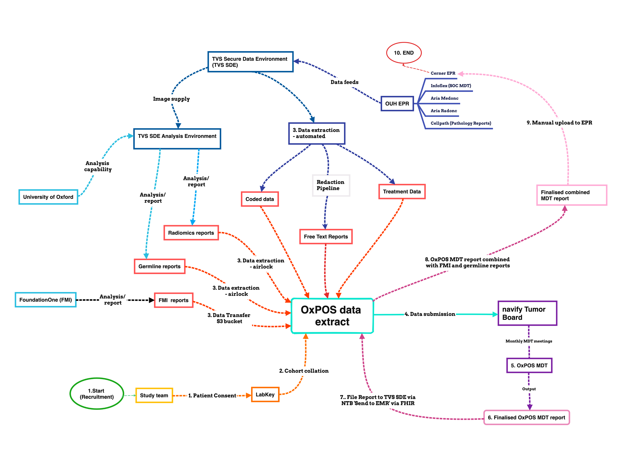
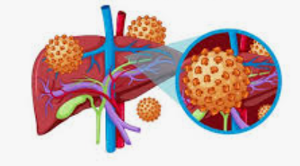
Present day impact
Multiple Myeloma
Arcturis
Built a synthetic control arm with SDE data
RWD commended by NICE
Supported approval of additional treatment for triple refractory patients
OXPOS (sarcoma)
Roche + University of Oxford
Largest sarcoma trial in Europe
SDE links and provides data, supporting product development and shadow MDT
“Best longitudinal dataset for Hepatitis B in Europe”
GSK + University of Oxford + NIHR BRCs
Planned linkage with UK HSA to track progress against WHO 2030 viral Hepatitis elimination target
Notes:
Kerrie – talk to impact

